Slide 1

Stage 3
Coulda Been Somebody
Course Designer: Marcel Englmaier
Coulda Been Somebody is a 40 round Pro-Am Par Time course. There are 32 Steel targets. The poppers must fall to score. The static square steel require 2 hits to score. The par time is 45 seconds. Any hits overtime(0.31s or more after the par time beep) will be considered a miss and time will be recorded as 45s. The start signal is audible.
The Handgun start position is standing completely outside any shooting area with wrists below belt. Handgun loaded and holstered.
The PCC start position is ding completely outside any shooting area. PCC loaded, stock on belt, safety on.
On the audible start signal, engage color-coded targets from within the respective shooting areas.
Times faster than 40 seconds will be recorded, otherwise you get 40 seconds due to PAR. Any full-diameter hit will count if steel does not fall. Steel left standing or static steel without 2 hits = 1 miss per occurrence.
Notes:
‹#›

Slide 2
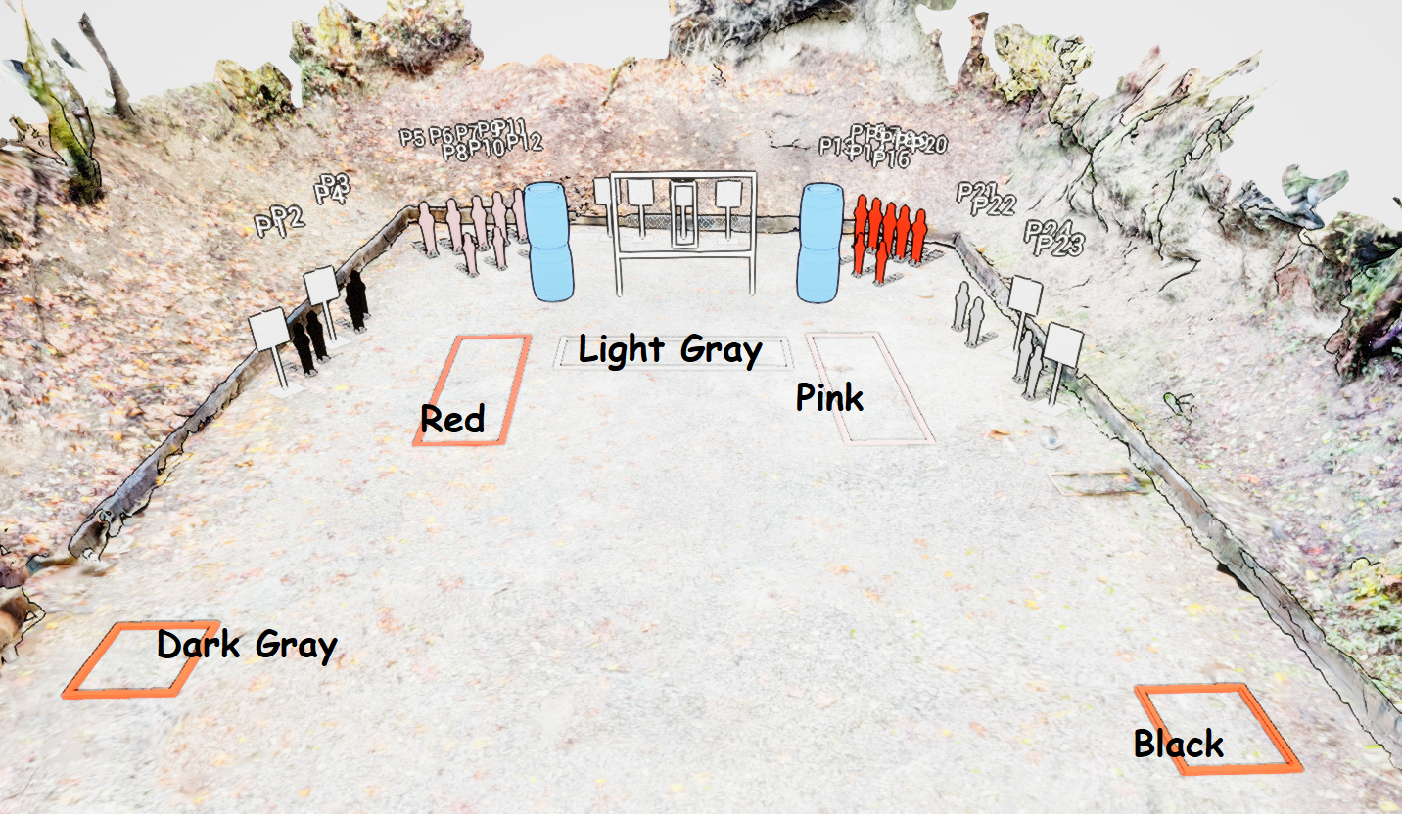
Stage 3
Coulda Been Somebody
Course Designer: Marcel Englmaier

